Slide 1
Science Gateways Community Institute: Developing Strategies for Sustainability of Projects via Bootcamps
Sandra Gesing
sandra.gesing@nd.edu
October 23, 2018
URSSI Workshop
Chicago, IL, Lisbon, Portugal

Slide 2
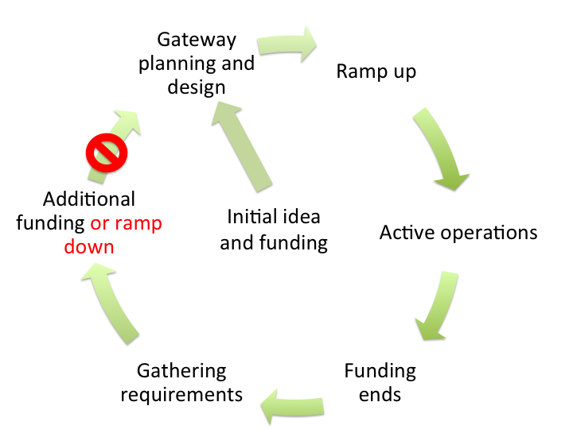
Lifecycle of a Science Gateway/VRE

Slide 3
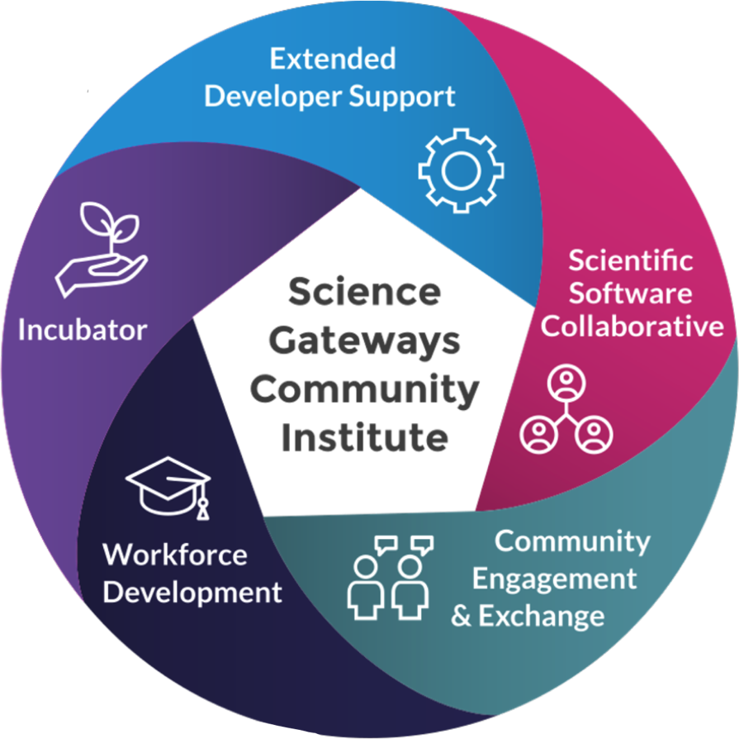

Science Gateways Community Institute
Diverse expertise on demand
Longer term support engagements
Software and visibility for gateways
Information exchange in a community environment
Student opportunities and more stable career paths
help@sciencegateways.org
http://sciencegateways.org/

Slide 4
Science Gateways Community Institute
Diverse expertise on demand
Longer term support engagements
Software and visibility for gateways
Information exchange in a community environment
Student opportunities and more stable career paths
help@sciencegateways.org
http://sciencegateways.org/

Slide 5
Incubator Service
A Framework for Decision Making
Technology Planning
Business Planning
Client Interaction Planning
Business model development
Financial planning
Project management
Software licensing
Staff and sustainability planning
Choosing technologies
Cybersecurity
Software engineering
Interfaces to compute and data
Usability studies
Web/visual/graphic design
Impact measurement
Community engagement
Support for education
Specialized Expertise
Network / Cohort Formation
Security
Sustainability
Evaluation & Impact Measurement
Campus Resource Development
Common Experiences
Training sessions
Group interactions
Continuing Engagement
Customized structure, content, goals
Mentoring
Pay It Forward
An Ongoing Dispassionate Ear

Slide 6
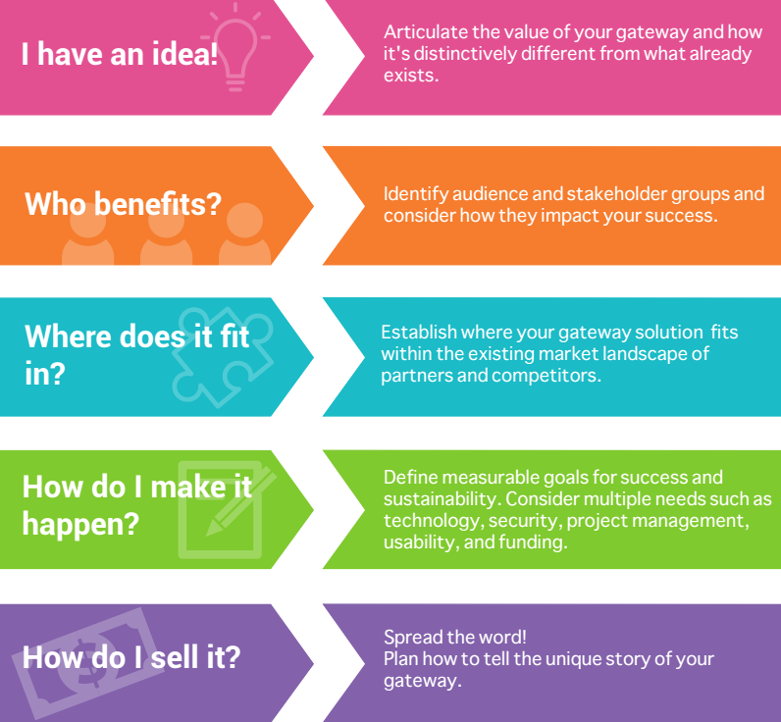
Bootcamp at a Glance
5 full days
Teams on science gateways
Knowledge dissemination
Interactivity
Community formation
Putting away the normal daily routine
Homework
Notes:
Take them out of the normal
Napkin drawing as introduction,
Bag their cellphones
Think like a business

Slide 7
COURSE PLAN
MONDAY
TUESDAY
WEDNESDAY
THURSDAY
FRIDAY
Your Audience(s) and Stakeholders
Mapping the landscape
Going beyond your initial market
Technology, Open Source
User Centered Design
Goal Setting
Budgeting
Cybersecurity
On-Campus Support
Funding
Models
Marketing & Outreach
Outreach
Your Sustainability Model – Making Your Case
Impact Measurement Case Study
Next Steps
Closing
Introductions
Course Outline and Goals
The “Napkin” Drawing
Defining Your Value Proposition
Notes:
Review full outline of the program.

Slide 8
COURSE PLAN
MONDAY
TUESDAY
WEDNESDAY
THURSDAY
FRIDAY
Your Audience(s) and Stakeholders
Globus Case-study
Mapping the landscape
Going beyond your initial market
Technology & Sustainability
Cybersecurity
Goal Setting
Budgeting
User-Centered Design
Marketing Tactics & Tools
Sales & Outreach
On-Campus Groups
Funding
Models
nanoHUB Case-study
Pitch Deck Alpha: Team presentations
Final Session
Introductions
Course Outline and Goals
The “Napkin” Drawing
Defining Your Value Proposition
Notes:
Review full outline of the program.

Slide 9
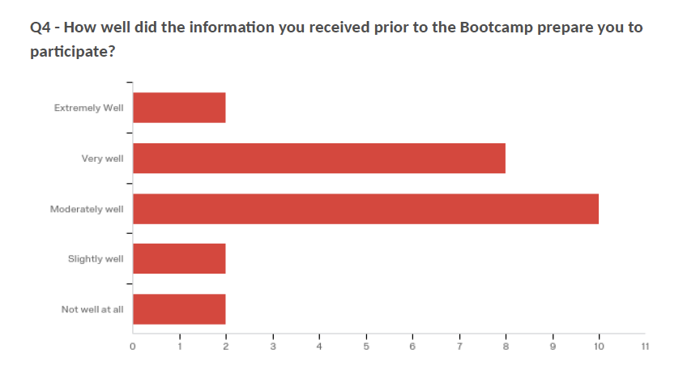
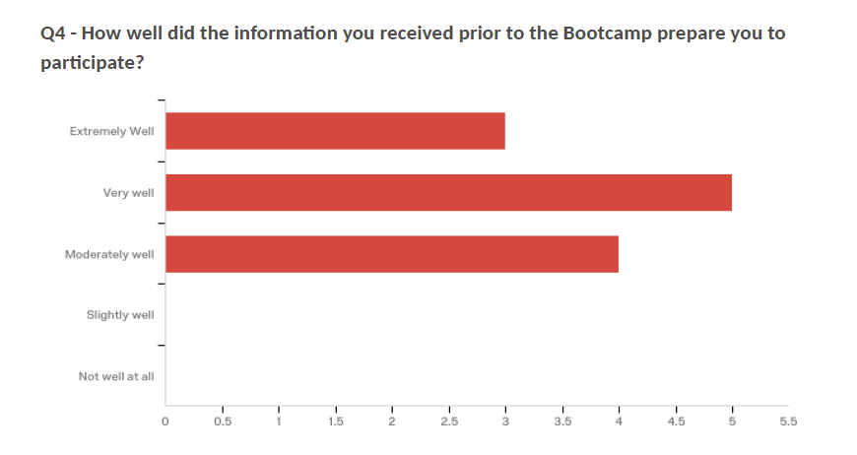
Bootcamps
twice per year
additional ones can be booked (travel expenses for presenters)
adapted to feedback
Bootcamp 1 Bootcamp 2
Notes:
Take them out of the normal
Napkin drawing as introduction,
Bag their cellphones
Think like a business

Slide 10
Mini Bootcamp
2-day Mini bootcamp in Edinburgh co-located with IWSG in 2018
Shorter program – feedback also enthusiastic but participants mentioned lack of time to let ideas sink in
"I found the Mini Bootcamp to be a very nicely arranged seminar on "distilled buisness for techies": a few practical tools to let you look at your Virtual Research Environment from a non-technical perspective, lead by energetic, knowledgeable, approachable, and charming instructors." Ander Astudillo, Consultant, SURFsara
I found the workshop to be well organized, enjoyable, and particularly beneficial for sharing a range of participant perspectives in reflecting on how we position our own ELIXIR life science research infrastructure services to a range of stakeholders." Jonathan Tedds, ELIXIR Compute Platform Coodinator, ELIXIR Hub
Notes:
Take them out of the normal
Napkin drawing as introduction,
Bag their cellphones
Think like a business

Slide 11
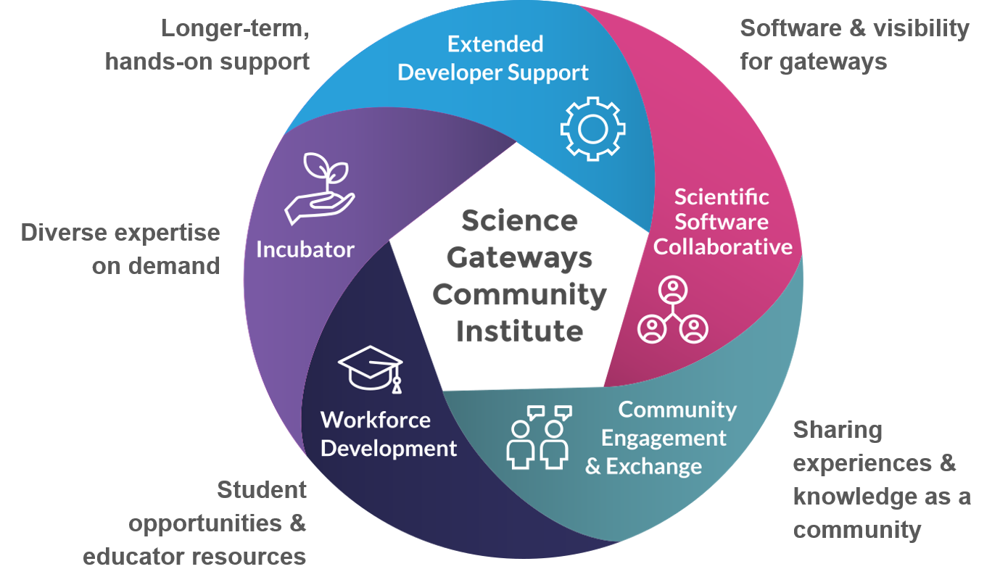
Thanks for your attention!
help@sciencegateways.org
http://sciencegateways.org/

